Slide 1






Capstone Project - E-Commerce
Presentation 2023
BUSINESS ANALYTICS
Sxxxx15E

Slide 2

Content
01
Overview
02
Objectives
03
Data information
04
Methodology
05
Data Cleaning
06
Findings
07
Recommendations
08
Future Scope

Slide 3





Overview
The project addresses the company's objective of building a customer base, enhancing customer experiences, recommending relevant products, and increasing revenue.
The project dataset, derived from a Shopee project in Brazil, includes essential details such as orders, customer demographics, product information, quantity, and shipping costs.
01
The primary focus is on generating a comprehensive report incorporating key performance indicators (KPIs) to facilitate well-informed business decisions..
02
Expected results encompass an improved comprehension of the customer base, identification of significant trends and patterns, and insights that can guide the development of strategies to enhance customer experience and increase revenue.
03
The insights derived are expected to play a pivotal role in shaping strategies for customer engagement, experience enhancement, and revenue growth..
04

Slide 4




OBJECTIVES
01
Doing research on the existing customer information to create a customer base, with the given dataset
02
Enhance customer experience and recommend relevant products
03
To enhance revenue based on the available information.

Slide 5


DATA INFORMATION
Customer:
Column Name | Description | Type | Unit
customer_id | Unique ID of the customers. | STRING | -
first_name | First name of the customer. | STRING | -
last_name | Last name of the customer. | STRING | -
gender | Gender of the customer. | STRING | -
age | Age of the customer. | INT | YEARS
country | The country names the customer is from. | STRING | -
income | Income of the customer | INT | -
Purchase:
Column Name | Description | Type | Unit
order_id | Unique order id of the order placed. | STRING | -
customer_id | Unique ID of the customer. | STRING | -
product_name | Product name. | STRING | -
description | The description about the product. | STRING | -
price | Price of the product. | DECIMAL | -
discount | Applicable discount on the product. | PERCENTAGE | -
tax | Applicable tax on the product. | PERCENTAGE | -
order_date | The date on which order was placed. | DATE | -
quantity | Quantity of the product being ordered. | INT | -
shipping_cost | The cost of shipping. | DECIMAL | -
shipping_date | The date of shipment. | DATE | -

Slide 6
ASSUMPTIONS
01
Remove 1 record from CUSTOMER table without purchasing record – 1000 customers
02
Delete 44 records from the PURCHASE table where the order date falls on January 1, 2023. Adjust the timeline to encompass the period from August 15, 2019, to December 31, 2022. – 49956 records
03
Comparison made based between Total Revenue vs Net Revenue in the absence of Profit
04
Shipping cost is excluded to reflect the core income from the primary products.

Slide 7
TABLE Customer
Table Name | Field | Description | Remarks
customer | [Group] Customer Age | Create customer Age Grouping using custom column | Group as follow : Age 10 – 20 Age 21 – 30 Age 31 – 40 Age 41 – 50 Age 51 – 60 Age 61 – 70
customer | FName | Concatenate First Name and Last Name for report use
Data Cleaning Process
TABLE Purchase
Table Name | Field | Description | Remarks
purchase | [Group] Shipping Cost | Create Shipping Cost Grouping using custom column | Group as follow : Ship $0 – 10 Ship $11 – 20 Ship $21 – 30 Ship $31 – 40 Ship $41 – 50 Ship $51 – 60
Purchase | Delivery Lead | Calculate the lead time based on difference between order date & shipment date | = Duration.From([shipping_date] - [order_date])
Purchase | Revenue | Based on (Price + Tax% ) * quantity | = ( [price] + [price]*[tax] )*[quantity]
Purchase | Net Revenue (Sales) | Based on Revenue – discount% | = [Revenue]-([Revenue]*[discount])

Slide 8
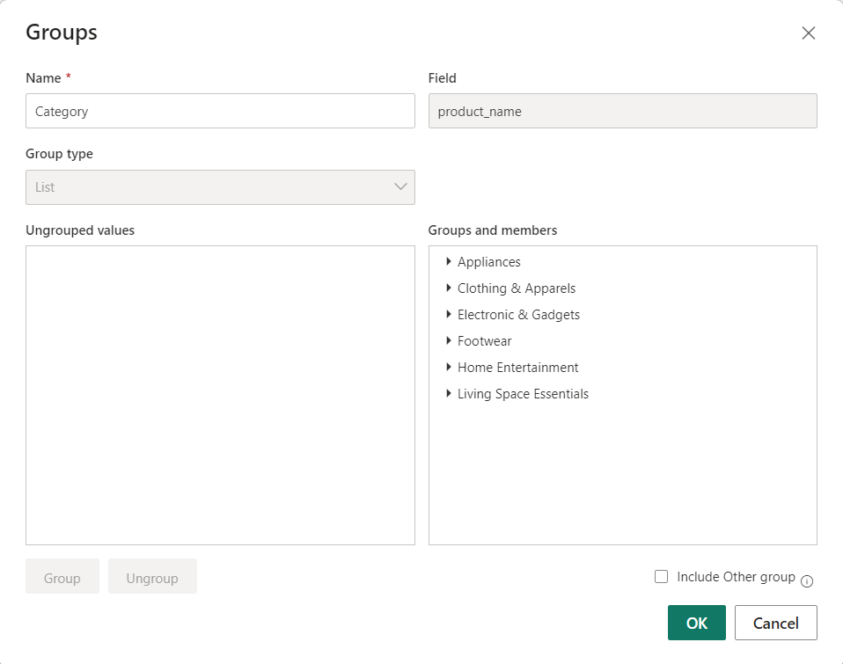
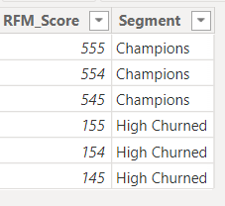
TABLE Purchase
TABLE RFM Chart
Create Product Category Grouping using Bin
Only available for String/Text Type
For RFM Score comparison use
Only interested in 6 score segment
Data Cleaning Process

Slide 9
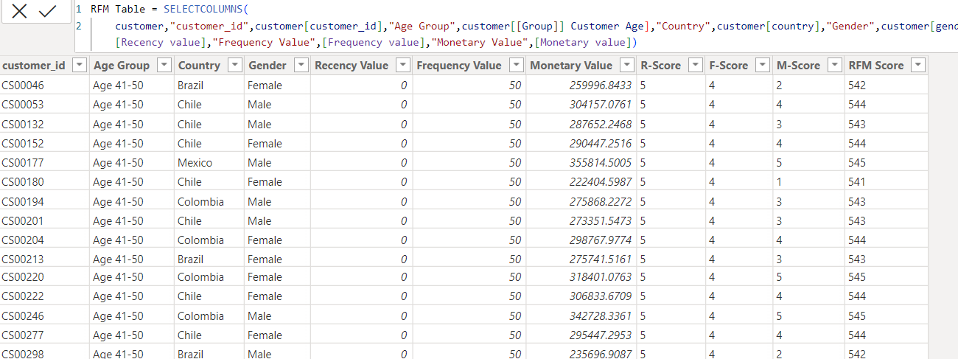
TABLE RFM
New Table append from Customer + Purchase retrieving fields for RFM Calculation
Data Cleaning Process
Table DimDate
For Time intelligence calculation
Create using Power Query / Advance editor to create Table DimDate.

Slide 10
Methodology - RFM Analysis in Marketing
Definition:
RFM analysis categorizes customers based on Recency, Frequency, and Monetary Value.
Customers are grouped into segments based on their RFM scores.
2. Key Dimensions:
Recency (R): How recently a customer made a purchase.
Frequency (F): How often a customer makes purchases.
Monetary Value (M): Total value of a customer's purchases.
3. Purpose:
It identifies who your customers are and evaluates their worth to your business
Gain insights into customer purchasing behavior.
Tailor marketing strategies for personalized engagement, loyalty programs, and CRM initiatives
4. Segments:
Champions,
Highly Churned,
Promising,
Loyal Customers,
Potential Loyalists,
Needs Attention,
At Risk
Methodology

Slide 11
Methodology - Visualisation
CHART REQUIREMENTS
Doing research on the existing customer information to create a customer base, with the given dataset.
Age
Location
Gender
Income
Their Needs/Requirements
Enhance customer experience and recommend relevant products.
Top 3 Best Sellers by Revenue, Total Quantity, and Total Orders
Bottom 3 Best Sellers by Revenue, Total Quantity, and Total Orders
Total Products Sold by Product Category
Distribution of Sales by Age, Location, Product Category
To enhance revenue based on the available information.
Categorizing customers and products to prioritize focus on specific groups
Use customer data to identify segments with high potential for upselling or cross-selling
To identify patterns in sales and devise promotional strategies for both online and offline channels
Methodology

Slide 12
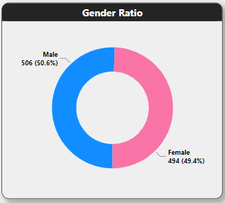
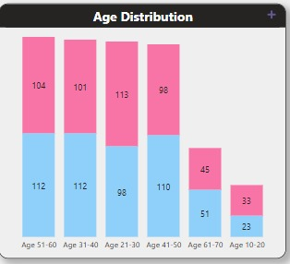
Findings
Balance Gender Distribution - The dataset demonstrates a balanced distribution between male and female entries
Proportional Representation Within Gender Groups - The distribution within the middle age range are relatively uniform.
Gender Demographics Across Age Groups – Males dominate in most Age Groups, except for Those Below 30

Slide 13
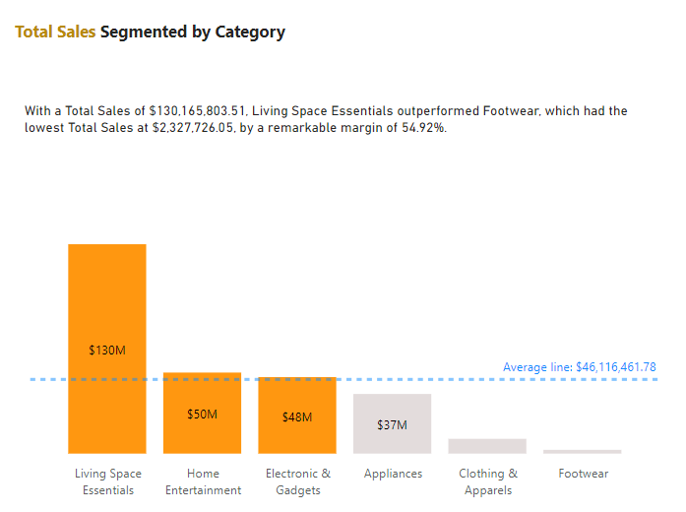
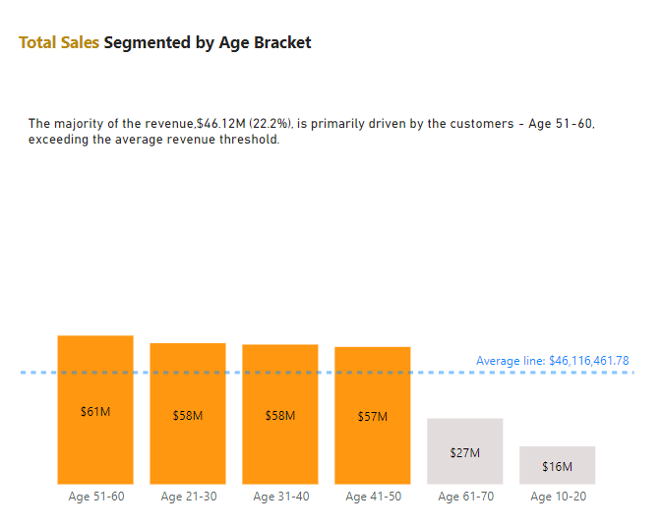
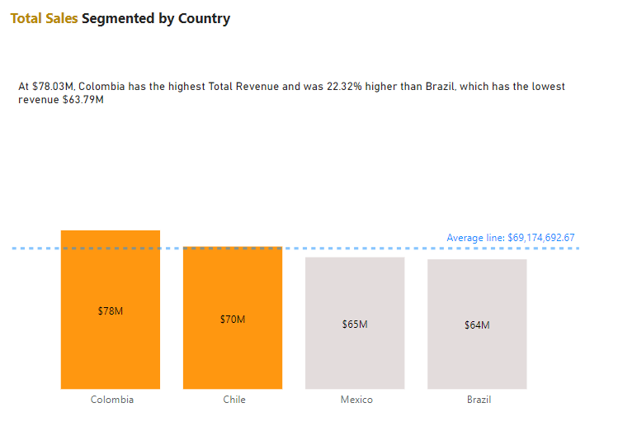
Findings
Disparities in Sales Distribution - 'Living Space Essentials' standing out as the most successful, while 'Appliances', 'Clothing & Apparels', and 'Footwear' underperform in comparison to the average sales line.
Outperformance Margin for Living Space Essentials - Discrepancy suggests a robust market preference or potentially higher pricing for products within the 'Living Space Essentials' category.
Lower Sales in Older and Younger Age Brackets - These figures fall significantly below the average sales line, suggesting that these age groups are not the primary customer base for the business.
Consistency in Middle Age Brackets - Implying either comparable purchasing power among these age groups or the company's products effectively meeting the needs of both demographics.
Top Performers - Colombia and Chile both exhibit total sales surpassing the average line of $69.17 million
Close Competition for Second: Chile's total sales is not far behind Colombia's.

Slide 14
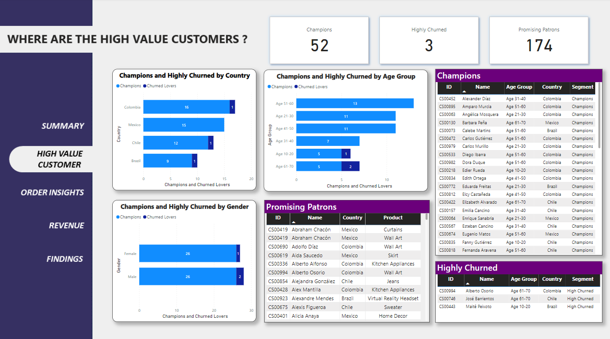
Findings
High-Value Customer Potential - Consisting of 22.9% of the total population (1000 individuals), this segment signifies a significant market sector distinguished by substantial purchasing power.
Champions - 52 individuals has been classified as 'Champions,' constituting a notably valuable subset.
Highly Churned - Identifying the 3 ‘Highly Churned' within the high-value segment signals a potential threat of losing valuable customers.
Promising – these customers exhibit characteristics or behaviors that indicate potential for future growth and increased value to the business and the opportunity to further engage, nurture, and convert these customers into more valuable and loyal patrons.
The varied categories within the high-value segment (Champions, Highly Churned, Promising) suggest diverse customer needs and behaviors.

Slide 15
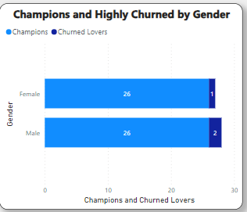
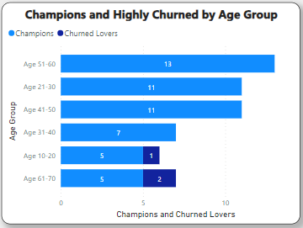
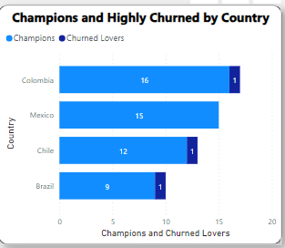
Findings
Equal Distribution of Champions between Male and Female Population
More Highly Churned for Male than Female Population
Could indicate a nuanced difference in customer retention challenges between genders
The age group 51-60 has the highest number of individuals identified as Champions.
Consistency is observed in the distribution of Champions across middle age groups, specifically within the range of 31 to 60.
The overarching pattern indicates a decline in the likelihood of being categorized as a Champion with increasing age.
There's a consistent count of Highly Churned (1) in three out of four countries
While Colombia has the most Champions, there is a close number in Mexico (15), indicating a small variance between these two countries in terms of 'Champions’.
Champions and Highly Churned diverged the most when the Country was Colombia, when Champions were 15 higher than Churned Lovers.

Slide 16
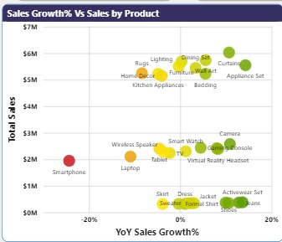
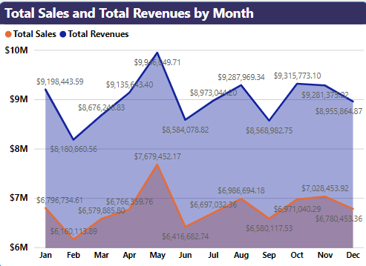
Findings
Sales Trend – Seasonal Trend with peaks around mid-year and end of the year.
Notable Dips and Peaks : There's a noticeable decline in 'Total Sales' in May, possibly suggesting a seasonal dip or an event that adversely affected sales.
High Sales and Growth – Dining Set, Curtains
High Sales, Low Growth – Rug , Home Decor
Low Sales, High Growth - Virtual Reality Headset and Smart Watch
Struggling – Skirt, Sweater, Formal Shirt
Market Leaders - Dining Set, Curtains

Slide 17
Recommendations
Focus on Customer Base from result of RFM Analysis
Champions - To ensure continued success, it is recommended to implement strategies aimed at preserving and strengthening the loyalty of the "Champions" customer segment.
Highly Churn - To address high churn, prioritize understanding the underlying reasons and execute targeted strategies to re-engage and win back customers.
Promising Patrons - Allocate resources to strategies that foster the growth and conversion of the "Promising" customer segment into loyal, long-term customers.
Consider aligning marketing and sales strategies around these events for Colombia + Chile:
Barranquilla Carnival (February/March)
Fiestas Patrias (National Holidays in September)
Boost Products Generating the Most Revenue
Curtains / Wall Arts – Both products are in the top 30% percentile of Total Quantity / Total Orders.
Lighting – The revenue is at the top of the list primarily due to being the most expensive product. Explore the option of finding products that are more affordable yet maintain a high-quality standard to attract a broader audience and boost sales.

Slide 18
Recommendations
4. Monitor products having greatest YOY% Increment
Appliance Set / Bedding – Both top-tier products are major contributors to the current year's revenue. To further capitalize on this success, explore cross-selling strategies, like providing discounts on Rugs or Home Décor with the purchase of these products, to enhance customer engagement and potentially boost overall sales.
To boost earnings from the product categories which falls below the Average Sales :
Diverse Product Assortment - Diversify the variety of each product in the categories to provide a broad selection that caters to various styles and preferences.
Limited Edition or Exclusive Products - Launch limited edition or exclusive products to evoke a sense of urgency and exclusivity, appealing to customers in search of distinctive and fashionable items.
Customer Loyalty Programs - Set up a loyalty program that incentivizes customers for recurring purchases. Provide exclusive discounts, early access to sales, or special promotions as part of the program.

Slide 19
Future Scope
The current dataset lacks certain key information for a more comprehensive analysis :
Product Profit – Shape the overall revenue of the company. ( Accounting Department )
Customer Martial Status – Understanding how customer marital status can affect purchasing behavior and revenue.( Sales & Marketing )
Customer Review – The influence of customer reviews on shaping brand perception and driving revenue. ( Sales & Marketing )
Having a more variety of products in the dataset
Establish a more specific product naming. Example for 'Shoes,' considering adding factors like color and size.
Set SMART goals
Specific – Define the specific goals your brand aims to achieve and the reasons behind them.
Measurable – Identify the primary metric for measuring success by selecting a quantifiable indicator, such as revenue, website clicks, or new followers.
Attainable – Assessing the feasibility of attaining the goal.
Relevant – Verify if the campaign aligns with your brand's marketing objectives. Else it lose its significance.
Time-based - Specify the timeline for achieving the campaign goal by clarifying the start and end dates of the campaign.

Slide 20


Shopee Brazil
THANK YOU
TING SK

